Slide 1

N.B.K.R INSTITUTE OF SCIENCE AND TECHNOLOGY (Autonomous) Vidyanagar,Tirupati-524413
TEXT TO IMAGE GENERATION
USING
STABLE DIFFUSION
Department of IT and AI&DS
Batch No : 09 Under the Esteemed Guidance of
Presented by
Mrs.M.SUJANA M.Tech,[Ph.D]
Assistant professor
Department of IT and AI&DS
20KB1A3034 – P. YUVARAJ
20KB1A3060 – V. SAI LEKHYA
20KB1A3051 – S.V. SURYA NARAYANA
20KB1A3050 – SK. ROSHNI
Page no: 01

Slide 2
INDEX
Abstract
Introduction
Literature survey
Parameters
Methodology Architecture
Implementation of Methodology
Results
Result Analysis
Conclusion
Page no: 02

Slide 3

ABSTRACT
Text-to-image generation is a challenging task aiming to generate realistic images from textual descriptions.
This stable diffusion approach using advanced deep learning architectures to effectively translate textual prompts into images.
This Model can takes a prompt from user in multi languages and it can generate efficient image.
Through extensive experimentation and qualitative analysis, we demonstrate the effectiveness and versatility of our proposed method.
Highlighting its potential applications in various domains such as creative design, content generation, and visual storytelling.
Page no: 03

Slide 4
INTRODUCTION
Synthetic Image generation is the creation of artificially generated images that look as realistic as real images.
In Previous, these images can be created by Generation Adversarial Networks(GAN) which use a generator-discriminator architecture to train, generate.
Now , we can use Stable Diffusion model using U-net and VAE to generate images by given prompt.
Page no: 04

Slide 5
LITERATURE SURVEY
S. No. | Year | Authors | Title | Outcomes
1 | 2015 | Xu et al. | alignDRAW: Aligning Text and Geometry for Image Generation | This paper proposes alignDRAW, a model that aligns text descriptions with geometric structures to generate realistic images from text descriptions.
2 | 2017 | Zhang et al. | Generative Adversarial Text-to-Image Synthesis (DCGAN) | This work introduces DCGAN, a framework for text-to-image synthesis using generative adversarial networks, which has shown promising results.
3 | 2018 | Zhang et al. | StackGAN: Text to Photo-realistic Image Synthesis with Stacked Generative Adversarial Networks | StackGAN utilizes a two-stage architecture to generate high-resolution images from text descriptions, achieving notable improvements in realism.
Page no: 05

Slide 6
Continue......
S. No. | Year | Authors | Title | Outcomes
4 | 2021 | Ramesh et al. | DALL·E: Creating Images from Text Using Adversarial Training | DALL·E is a model capable of generating diverse images from textual descriptions, demonstrating the ability to understand and generate complex scenes.
5 | 2023 | Ramesh et al. | DALL·E 3: Further Explorations in Text-to-Image Generation | DALL·E 3 extends the capabilities of the original DALL·E model, exploring new directions in text-to-image generation and achieving improved performance.
6 | 2022 | Gao et al. | Stable Diffusion Models for Text-to-Image Generation: Initial Exploration | Stable diffusion models are explored for text-to-image generation, demonstrating improved stability and convergence during the generation process.
7 | 2023 | Chen et al. | Stable Diffusion Models for Text-to-Image Generation: Addressing Limb Generation Issues | This update focuses on fixing issues related to limb generation in stable diffusion models for text-to-image generation, enhancing overall image quality.
Page no: 06

Slide 7
PARAMETERS
Data Dreamer: A powerful open-source Python library for prompting, synthetic data generation, and training work flows. By providing diverse and detailed text prompts, Data Dreamer can create synthetic datasets.
Mistral 7B Instruct v0.1: As a large language model, Mistral can be used to generate synthetic textual data like any form of text content.
SDXL Lightning: It can generate high-quality 1024px images in a few steps. Making it useful for creating synthetic visual data
PEFT : PEFT is a method for efficiently fine-tuning large models like Stable Diffusion by only updating a small set of newly introduced parameters.
Page no: 07

Slide 8
5. LoRA : LoRA is a specific implementation of efficient fine-tuning for Stable Diffusion and other diffusion models. It introduces trainable low-rank matrices that are combined with the pre-trained weights during inference.
6. VAE (Variational Autoencoder): Stable Diffusion uses a VAE to encode and decode images and from a latent space, allowing for efficient processing in the latent representation.
7.Text Encoder: This component encodes the input text prompt into a representation that guides the image generation process, typically using a pre-trained language model like CLIP.
8. U-net: The core convolutional neural network architecture used in Stable Diffusion, that can be used for extracting image features and generating images for given text prompt.
Page no: 08

Slide 9
9. Forward Diffusion: The process of gradually adding noise to the latent representation of an image, turning it into pure noise over several steps. This is the first stage of the diffusion process.
10. Reverse Diffusion: The reverse process, where the model learns to iteratively remove noise from the pure noise representation, eventually producing a denoised image matching the input text prompt.
11. Qualitative Evaluation: This involves subjective, human evaluation of the generated images, assessing factors like visual quality, coherence with the text prompt, and overall realism/plausibility.
Page no: 09

Slide 10
12.Quantitative Evaluation: This refers to objective, numerical metrics for assessing Stable Diffusion's performance.
13.CLIP Score: A quantitative metric that measures how well a generated image matches the input text prompt by computing the similarity between their representations in the CLIP (Contrastive Language-Image Pre-training) model's embedding space.
14. CLIP Directional Similarity: An extension of the CLIP Score that specifically measures how well the generated image aligns with the "direction" of the text prompt in the CLIP embedding space.
Page no: 10

Slide 11
15. Hugging Face: Hugging Face is a platform and community for hosting, sharing, and deploying machine learning models, including Stable Diffusion and other diffusion models.
16. Diffusers: Diffusers is a Python library developed by Hugging Face specifically for working with diffusion models like Stable Diffusion. It provides utilities for training, fine-tuning, and deploying diffusion models.
Page no: 11

Slide 12
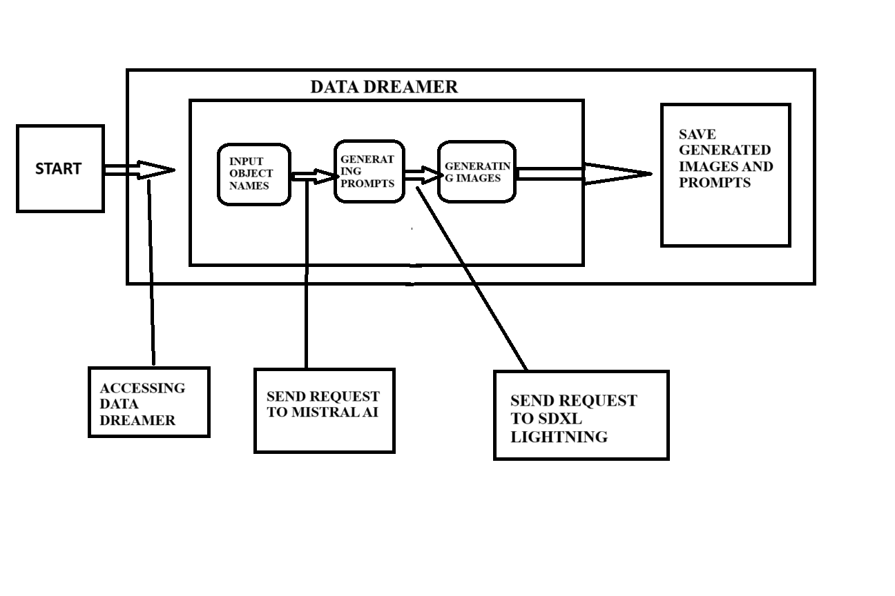
METHODOLOGY ARCHITECTURE
Data Dreamer :
Page no: 12

Slide 13
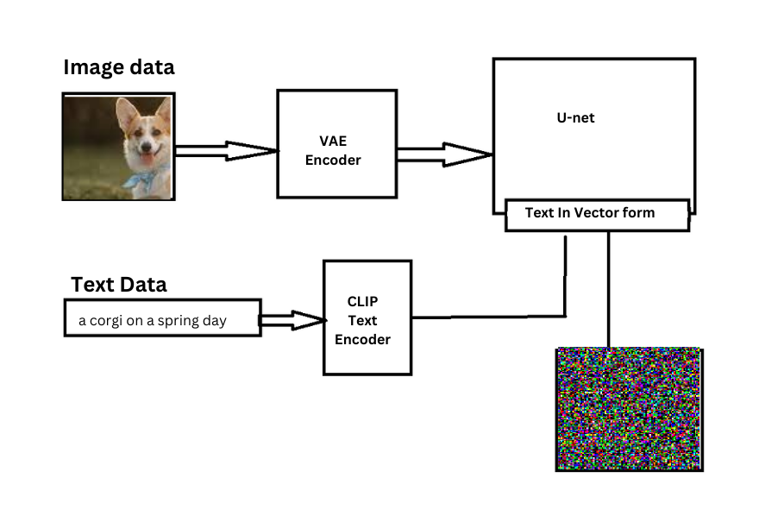
Forward Diffusion:
Page no: 13

Slide 14
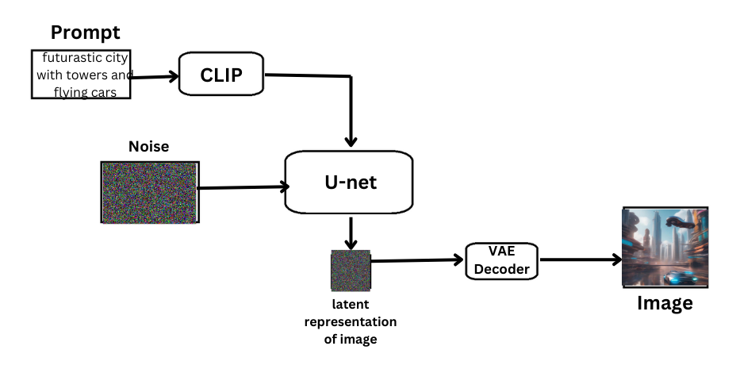
Reverse Diffusion:
Page no: 14

Slide 15
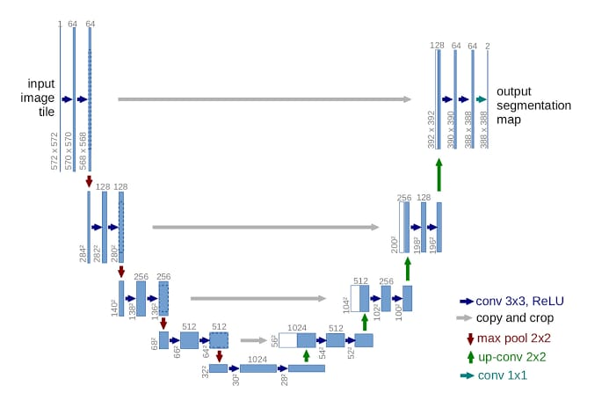
U-net
Page no: 15

Slide 16
Implementation of Methodology
Set Up Environment:
Before Moving dive into project first check available resources to move further.
Check the GPU available in environment or not. Install cuda toolkit for GPU acceleration.
Use Google colab or Kaggle Notebooks for free GPU access and pre-configured environments.
Data Collection:
Data Dreamer is a Python library that can be used for generating synthetic image-text pairs.
Data Dreamer internally utilizes Mistral 7B and SDXL lightning for generating text as well as image.
Page no: 16

Slide 17
Model Training:
During fine-tuning, the U-Net and the VAE are the primary components that are updated based on the new training data.
For Fine-tune model we use techniques like PEFT, hyper network and LoRA. By using these techniques we train model on few parameters.
These techniques also useful training model on low end RAM’s(min 11 GB) and save model with low space.
Model Testing:
Use the fine-tuned model to generate sample images from text prompts relevant to your domain or task.
Leverage the Diffusers library to generate images using the fine-tuned weights.
Page no: 17

Slide 18
Model Evaluation:
Qualitative Evaluation:
Conduct a subjective evaluation of the generated images by visually inspecting them. Assess factors like image quality, coherence with the text prompt, and overall realism.
Quantitative Evaluation:
Calculate metrics like CLIP Score and CLIP Directional Similarity to measure how well the images match the text prompts.
Model Deploy:
At last deploy my fine-tuned model on Hugging Face Spaces for easy sharing and online inference.
Then integrate the model into your web application using Hugging Face's inference API.
Page no: 18

Slide 19
RESULTS
In text-to-image generation, the expected result is typically an image that accurately represents the content described in the input text.
This could involve generating realistic scenes, objects, or even abstract concepts based on the textual description provided.
The goal is to create visually coherent and semantically meaningful images that align with the given text.
Page no: 19

Slide 20
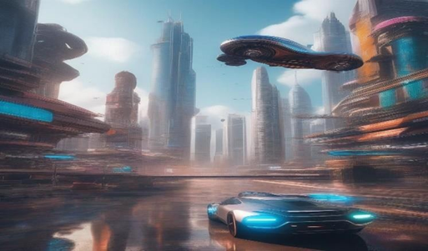
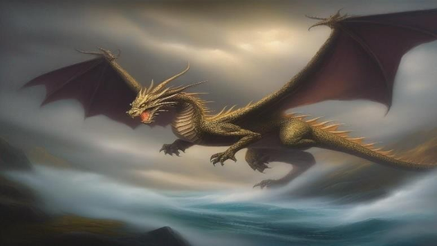
PROMPTS | GENERATED IMAGES
A photograph of a vibrant, futuristic city skyline with towering skyscrapers and flying cars.
An oil painting of a majestic dragon soaring through a stormy, fantasy landscape.
Page no: 20

Slide 21
RESULT ANALYSIS
When analyzing the results of a text-to-image generated model, several factors need to be considered to evaluate the performance. Here are some key aspects to consider:
Quality Evaluation : Qualitative evaluation typically involves human assessment of generated images. Quality is measured across aspects such as compositionality, image-text alignment, and spatial relations.
Quantity Evaluation : In this section, we will walk you through how to evaluate three different diffusion pipelines using:
CLIP score (36.85).
CLIP directional similarity (69.85).
Page no: 21

Slide 22
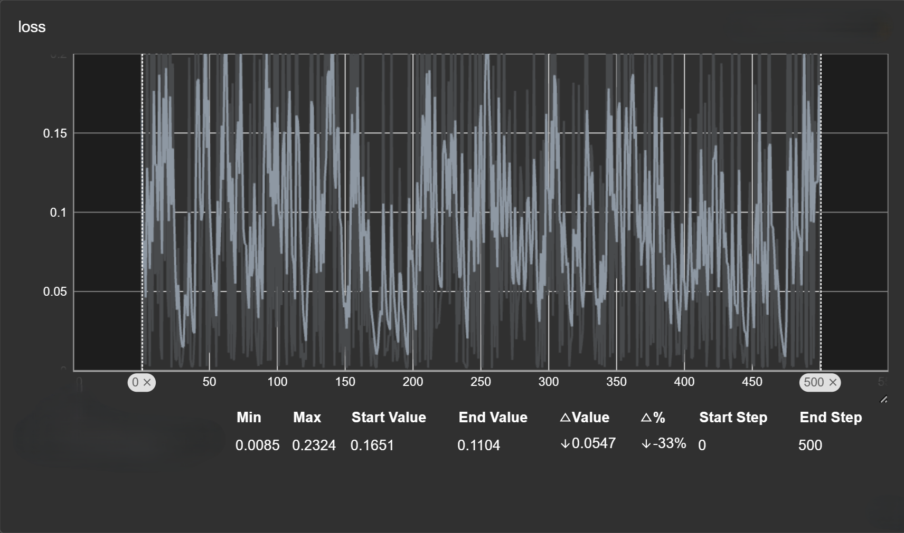
Loss Function:
Page no: 22

Slide 23
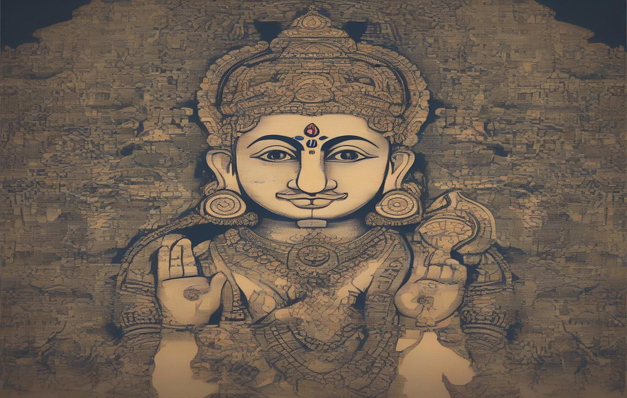

COMPARISION
Old model:
New model:
మహోన్నతమైన ఆకాశహర్మ్యాలు మరియు ఎగిరే కార్లతో కూడిన శక్తివంతమైన, భవిష్యత్ నగర స్కైలైన్ యొక్క ఛాయాచిత్రం.
మహోన్నతమైన ఆకాశహర్మ్యాలు మరియు ఎగిరే కార్లతో కూడిన శక్తివంతమైన, భవిష్యత్ నగర స్కైలైన్ యొక్క ఛాయాచిత్రం.
Page no: 23

Slide 24
Continue……
Old Model | New Model
It can support only English to give prompts. | It can support multi languages to give prompt.
Image Resolution is 512. | Image Resolution increases 512 to 1024.
Clip Score is 35. | Clip Score increases from 35 to 36.85 .
Clip bidirectional similarity 69.20 . | Clip bidirectional similarity 69.85 .
Page no: 24

Slide 25
CONCLUSION
Text-to-image generation is a rapidly advancing field, with new techniques and models being developed regularly.
We proceed with traditional fine-tune. Take this as a step and go further for exploring
different methods, tools and technique like dream booth and compify UI.
Exploring these different methods can lead to new insights and advancements in text-to-image generation, enabling better control, personalization, and manipulation of the generated images.
Page no: 25

Slide 26
THANK YOU
Page no: 26

